Slide 1
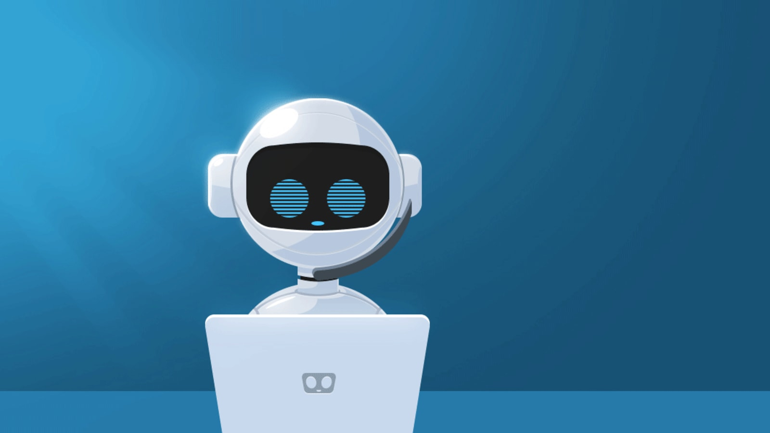
Menu based Program
ARTH 2.0 Group 4
(41-50) Team1

Slide 2
TEAM MEMBERS
1.Tinkal Shakya(Roll No:-44)
2.Rohit Jain (Roll No:-43)
3.Ankit Shukla (Roll No:-47)
4.Rahul Raipurkar (Roll No:-45)
5.Siddharth Pradhan (Roll No:-49)

Slide 3
PROBLEM STATEMENT
There is a need of assistant who can perform configure, run commands, estimation
Those students who are beginner in redhat OS so how can they use and setup multiple services of OS.
To Predict a salary quickly there was a problem associate with it i.e lots of computation
In docker tool we have many commands, so some time it is one kind of challenge for students to remember all commands.

Slide 4
SOLUTION
By using python and other tools we developed assistant.
Using this assistant, we can easily setup some kind of services.
This assistant can also help in remembering the docker commands and their implementation
This assistant can also help in voice assisting in Hindi , English (Male and Female)
We can also simply predict the salary using linear regression.

Slide 5
HOW IS THE SOLUTION INNOVATIVE
With the help of this tool the user who are very new in docker and ML so they can easily use these technology and can also learn the docker command.
If we use this tool so we can easily tackle lots of problems
It can configure services quickly
It reduces the computation of human being and also help in time saving.

Slide 6
IMPACT ON BUSINESS / SOCIETY (How it will impact the current trend)
It can help in assisting user by responding and providing assistance as per need with the Technology (chat bot)
Promote use of right education in society / corporate
User will get excited and get to know how to integrate multiple technologies.
It can help in IT as a technical assistant who can configure services remotely by scheduling jobs.

Slide 7
FEATURES
Easy to use
Easy to setup docker and services.
We can easily run redhat command.
We can provide the list of item and they easily search of any item.
We can also simply predict the salary using linear regression.

Slide 8
TECHNOLOGY YOU ARE PLANNING TO USE
Python
RedHat
Docker
Machine Learning

Slide 9
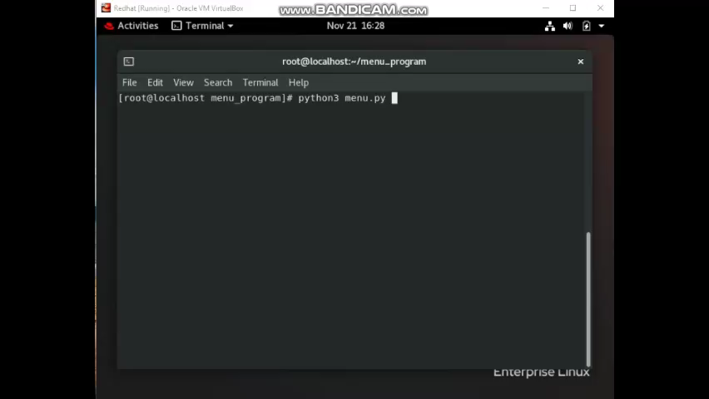
Demonstration

Slide 10
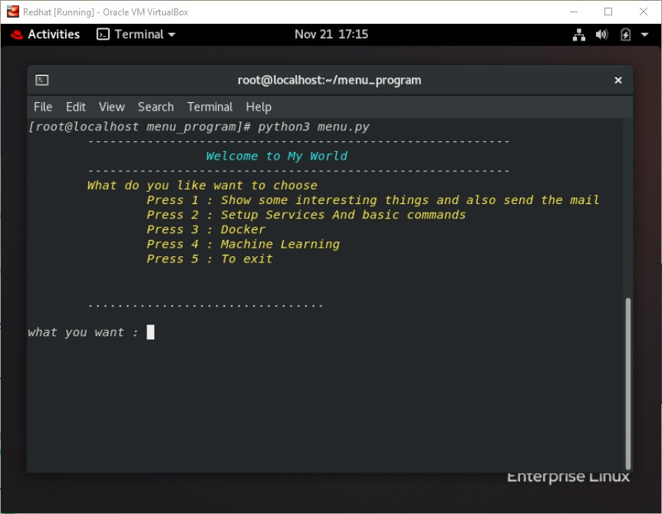
Screenshots

Slide 11
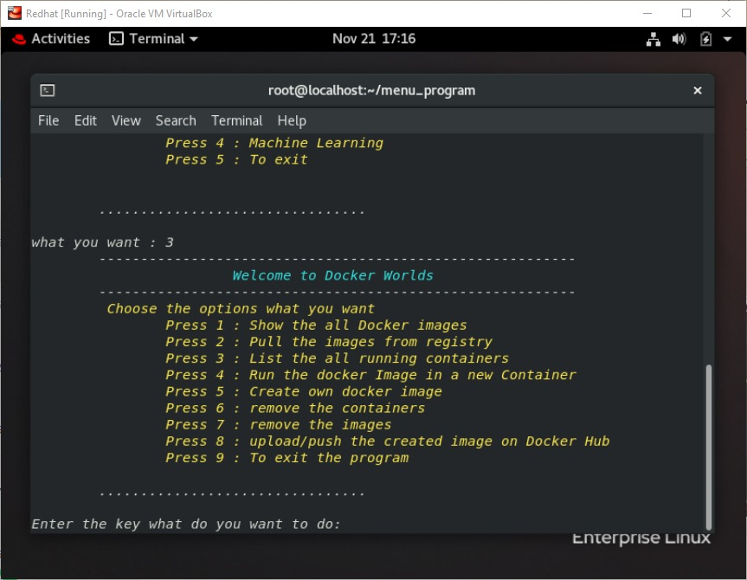
Screenshots

Slide 12
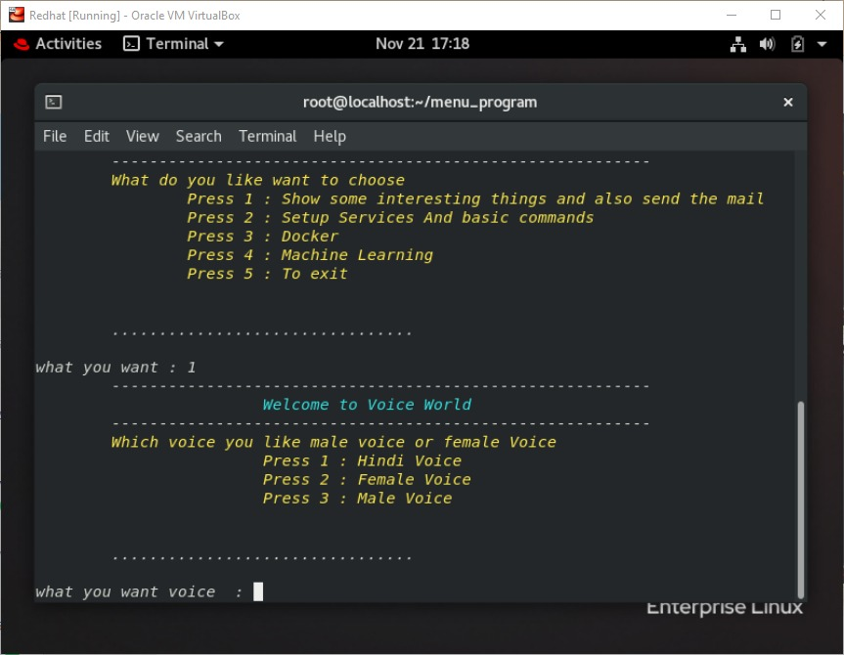
Screenshots

Slide 13
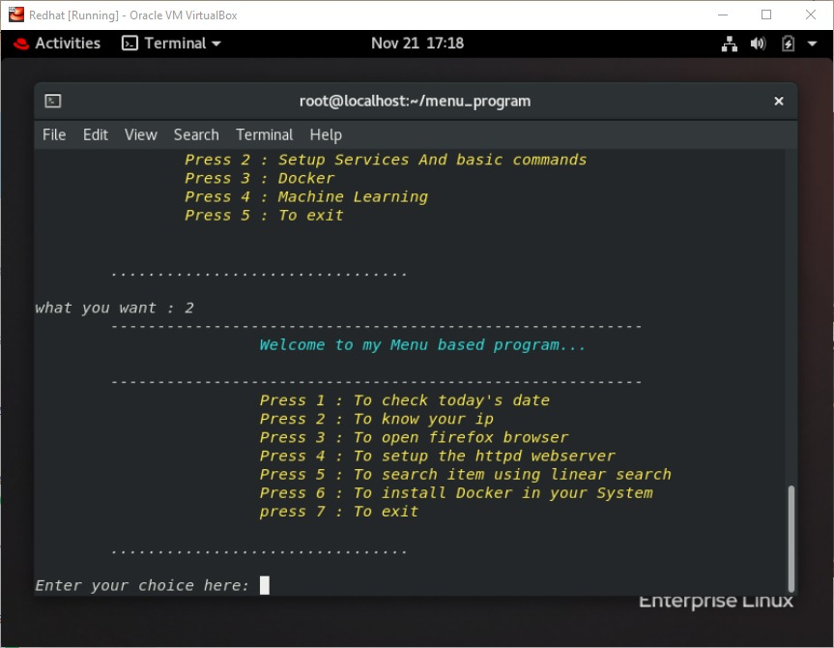
Screenshots

Slide 14
Thank You

